Slide 1






A Complete Guide To
Module 1: WEBSITE CREATION

Slide 2



Agenda
KEY TOPICS DISCUSSED IN THIS PRESENTATION
Understanding the Website Importance
Understanding Website Basics
Website Creation Tools
Installing WordPress on Localhost using FlyWheel
Install WordPress on Localhost using XAMPP
Applying Security on Your Website Through Wordfence
Installling Other Plugins
Creating your Own Website

Slide 3






Understanding the Website Importance

Slide 4
Planning & Concept
Purpose and Goal Content Graphics / Branding Which Tool to Use
Notes:
1.) jazz.com.pk, zong.com.pk (explain content part), content creation responsibility ? -> designer
2.) explain branding, logo, theme
3.) Tool for designing - canva, illustrator, photoshop. Same we have different tools for making websites - wix, shopify, wordpress, etc

Slide 5

Types of Websites
Corporate Website
Personal Website
Classified Website
Social Media Website
E-commerce Websites
Forums
Educational Website
Government Website
Entertainment Website
Many more
Notes:
Bata has two websites,
1.) bata.com.pk - ecommerce website
2.) thebatacompany.com - corporate website
Gulahmed has two websites,
1.) gulahmed.com - corporate website
2.) gulahmedshop.com - ecommerce website
Unilever has
1.) unilever.pk - corporate website
3.) Classified website :
website where one can place ads ? - contains ads, olx, zameen.com, pakwheels.com, rozee.pk, etc.
But why not daraz? alibaba? are classified ? They are somehow similar as both used for selling but their business model is different.
On olx anyone can place the add but this is not the case with daraz, alibaba.
Daraz, alibaba type websites own the product but this is not the case with olx.
4.) Ecommerce website:
As mentioned above, two more types
1.) multiple vendor, (daraz, alibaba)
2.) single vendor (khaddi, sapphire, etc)
5.) Social media website:
Linked in, Facebook, Instagram
6.) Educational website:
Udemy, Khan acedmy, Coursera, Universities websites, etc
7.) Government website:
NAB, Nadra, LESCO, etc
8.) Entertainment Website:
Netflix, Amazon Prime, Spotify, Dailymotion, Youtube, etc.
One website can be fall in more than one category, e.g., tiktok (both entairtainment, social media category)

Slide 6
Understanding Website Basics

Slide 7
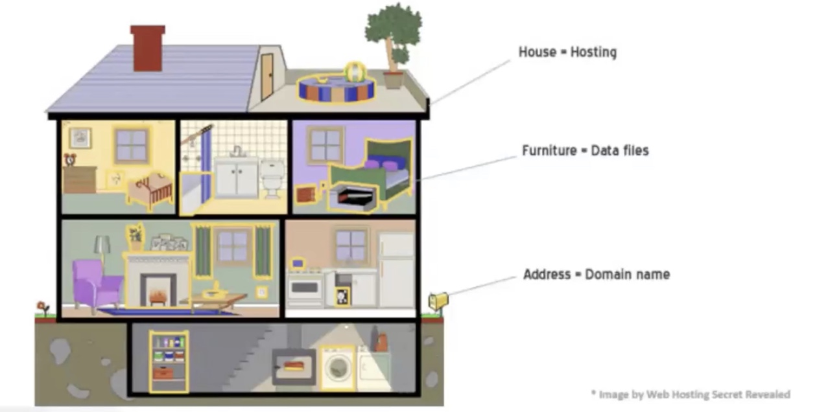
Domains & Hosting

Slide 8

Where to Buy Domain and Hosting
Reliable Sources | Other Options
Hostinger.com Namecheap.com Thebeehost.com Hostgator.com Bluehost.com Hostbreak , and many more | GoDaddy.com (Low Quality) A2Hosting.com (Expensive) Dreamhost.com (Expensive) KnownHost.com (Expensive) Cloudways.com (Expensive)

Slide 9
Searching for a Domain Name
Domains available on multiple platforms, pricing may vary Different domain extensions have different prices (e.g., nimra.com vs nimra.org) Some domain extensions are limited or restricted: For example: Getting a .pk Domain .pk domains can be purchased from: pknic.net.pk, or any other Pakistani hosting companies like “thebeehost.com” Local providers offer .pk domains with region-specific benefits

Slide 10
Domain Ownership and Transfer
If domain doesn’t suit your business, it can be sold/transferred to others
Transfer process involves:
Contacting your domain registrar/hosting provider
Sharing credentials securely
Registrar handles the ownership transfer
Transfer can be lengthy, details usually handled by hosting company

Slide 11
Tips for Choosing a Domain Name
Keep it short and simple Easy to remember Match domain name with your target audience Example: Brands like “Minnie Minors, Hopscotch” target modern, educated users Use generic, brandable names (e.g., ECS instead of “Ehsan Chappal Store”)

Slide 12
Domain Naming Do’s and Don’ts
Avoid numbers unless part of your brand (e.g., McDonald’s, not McDonald1)
Avoid special characters (e.g., &, $, etc.). These are also not allowed.
Hyphen (-) is allowed but not recommended
For Example:
K&N’s domain is written as KandNs.pk without special characters

Slide 13
Different Types of Hosting
Web hosting provides space on a server to make websites accessible online Different types of hosting cater to different needs and budgets
1.) Shared Hosting Multiple websites share the same server resource Cost-effective and beginner-friendly Ideal for small websites or blogs 3.) Dedicated Hosting Entire physical server dedicated to one user Full control, high performance, and better security Best for large websites or high-traffic applications | 2.) Virtual Private Server (VPS) Hosting Server split into virtual servers for each user More control and resources than shared hosting Suitable for growing websites with moderate traffic 4.) Cloud Hosting Resources come from multiple servers (cloud infrastructure) Highly scalable and flexible Pay-as-you-go pricing with high uptime

Slide 14
Different Types of Hosting (Cont...)
5.) Managed Hosting Hosting provider manages the server, updates, and security Can be shared, VPS, or dedicated but with management services Ideal for users who want to focus on their website without server management 7.) WordPress Hosting Optimized specifically for WordPress sites May include pre-installed WordPress, automatic updates, and security features | 6.) Reseller Hosting You buy hosting resources and resell them to others Suitable for businesses or individuals offering hosting services

Slide 15
Things to Check Before Buying
Many types of hosting exist, but we will focus on Shared Hosting Shared Hosting is the least powerful and most affordable option Ideal for beginners and small websites Also known as web hosting To select shared hosting: Visit your hosting provider’s website Navigate to the hosting section from the menu Choose Web Hosting / Shared Hosting option Plans usually comes as: Standard performance High performance

Slide 16
Important Features That Impact Cost
It includes : disk space/storage, number of domains allowed, bandwidth, SSL certificate, and number of domain emails 1.) Disk Space/ Storage Disk space defines how much data your website can store The domain name affects branding, but hosting affects website performance, security, and storage Hosting plans vary: 2GB, 4GB, 10GB, 20GB, 50GB, etc Most websites require 2-3 GB; larger sites may need 10 GB or more Choose hosting with enough disk space for your website’s needs

Slide 17
Important Features That Impact Cost
2.) Number of Domains Allowed
Hosting plans specify how many domains/websites you can host
If you own multiple businesses, you may need multiple domains
You can attach multiple domains/websites to a single hosting plan if the storage and plan allow it
Check hosting plans for the number of websites allowed before purchase
Example: A 40GB hosting plan may allow hosting multiple domains easily
3.) Bandwidth
Bandwidth = The amount of data your server can transfer to visitors
Minimum recommended bandwidth: 10 GB per month
More bandwidth means better handling of traffic and faster website speeds
Example: On sale days with high traffic, adequate bandwidth prevents website crashes
10 GB bandwidth can handle approximately 8,000-10,000 visitors monthly
Bandwidth also impacts website loading speed

Slide 18
Important Features That Impact Cost
4.) SSL Certificate SSL = Secure Socket Layer, adds security to your website Like vaccinations protect children, SSL protects your website from cyber threats Converts your URL from http:// to https://, encrypting user data Protects user information such as login details, payments, and personal data SSL certificates are often included free with hosting plans Easy to install with a click in most hosting control panels 5.) Number of Domain Emails Professional email accounts linked to your domain name (e.g., info@yourdomain.com) Important for brand trust and communication Check hosting plans for the number of included email accounts
Notes:
here (one hour)

Slide 19

Website Development Options
Two main ways to develop websites:
Offline practice: Using tools like XAMPP or Flywheel (free, local environment)
Online: Buy domain and hosting and publish the site on the internet.

Slide 20

Types of E-commerce / Online Services
You can run:
Local e-commerce targeting nearby customers
Online services (teaching Quran, cooking, coding, etc.)
Personal branding or freelancing
E-commerce Examples: (Go for brand names instead of generic ones)
Successful brand examples:
Dari Mooch (darimooch.com)
MENDEEZ (mendeez.com)
FittedShop (fittedshop.com)
TIFMO (tifmo.co)

Slide 21
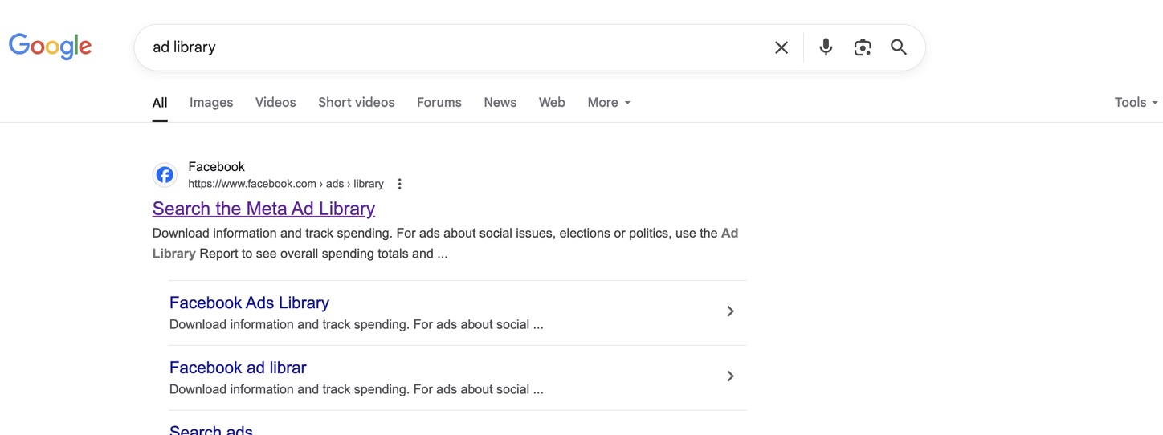
Product/Service Validation
Use tools to validate your product/service idea: Google Trends for search popularity Facebook Ads Library to check competitor ads and popularity Search product ads to see if they are actively running Longer-running ads usually indicate successful products

Slide 22
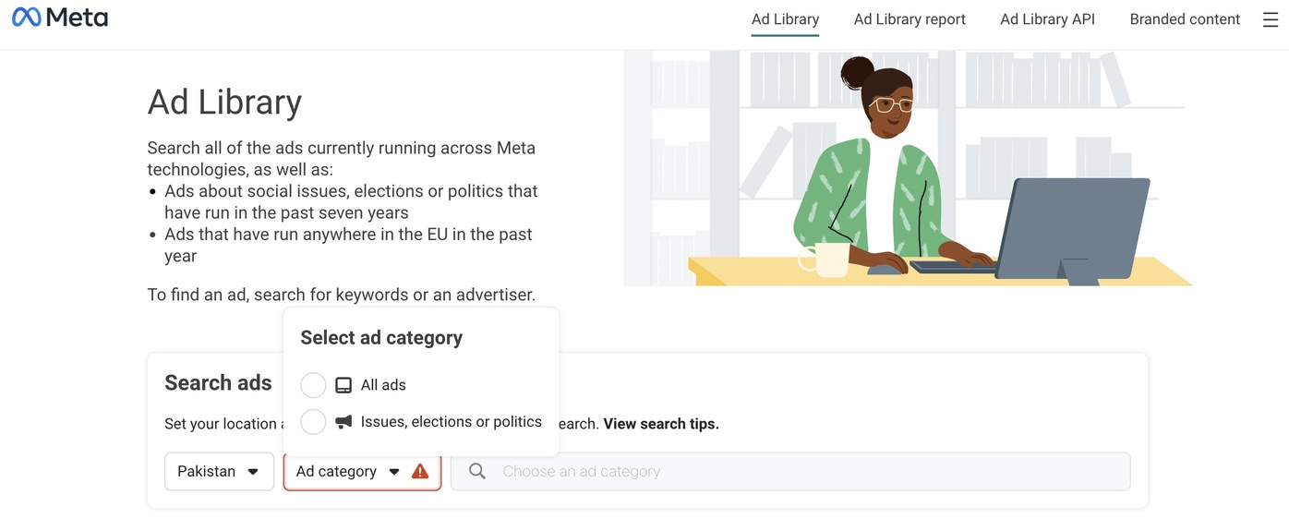
Product/Service Validation

Slide 23
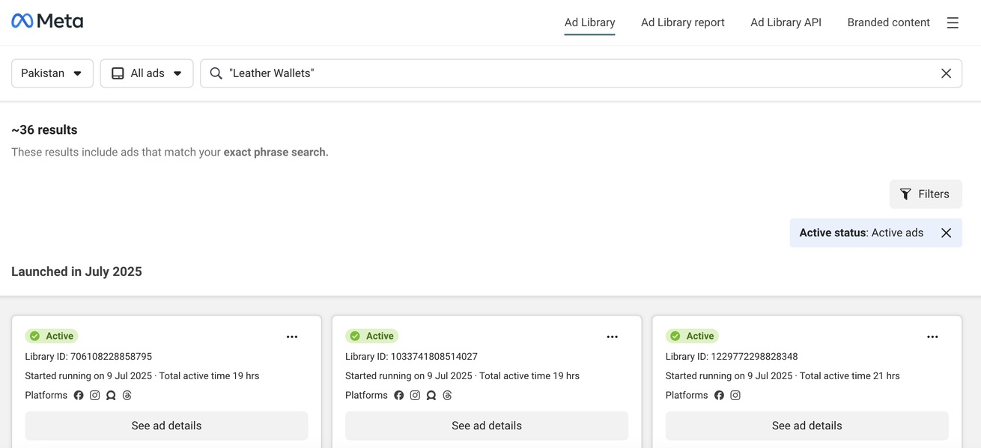
Product/Service Validation

Slide 24
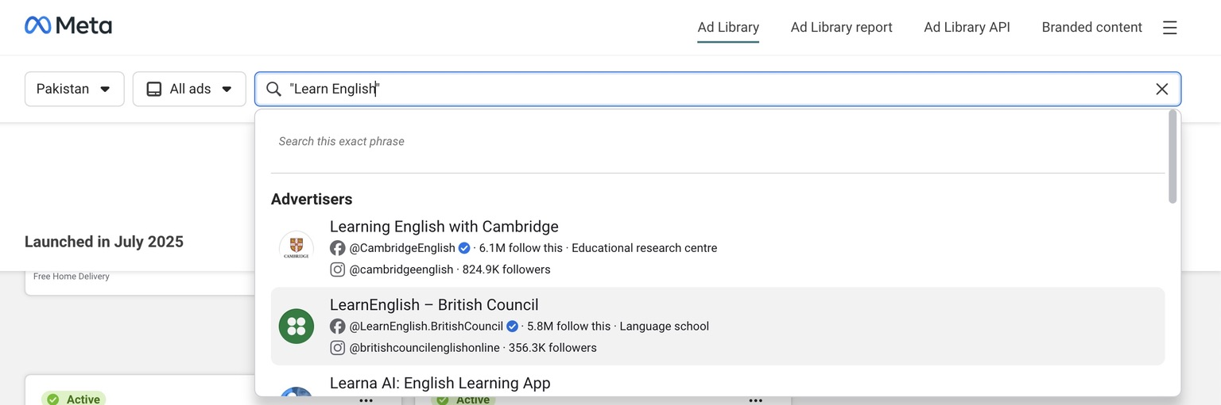
Product/Service Validation

Slide 25
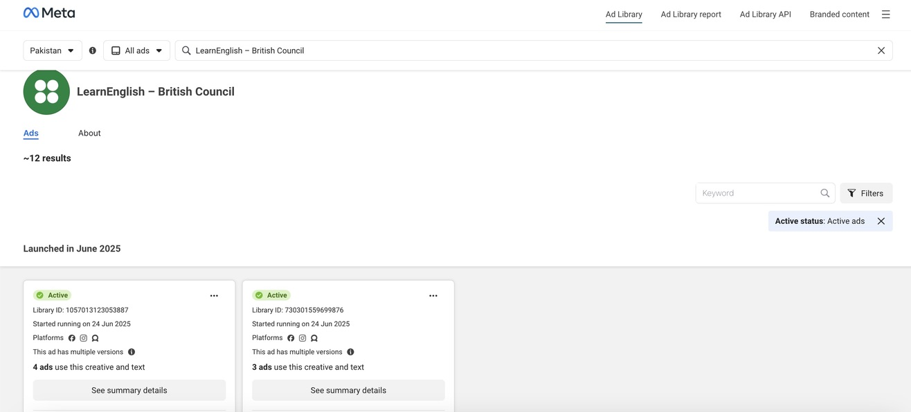
Product/Service Validation

Slide 26

End of Lecture

